Slide 1

Phumbling with Phoenix
Phoenix and vulnerability finding
tim.burrell@microsoft.com

Slide 2
The plan
What is Phoenix?
Example uses
An MSRC case - CreateTextRange
Analysis/Demo

Slide 3
Phoenix
Cool name and icon :)
Some documentation/support
http://connect.microsoft.com/phoenix

Slide 4
Phoenix compilation
S
O
U
R
C
E
O
B
J
E
C
T
C
I
L
AST
HIR
MIR
LIR
EIR
not Phx
(yet)
CIL Reader
Type Checker
MIR Lower
SSA Const
SSA Dest
Canon
Addr Modes
Lower
Reg Alloc
EH Lower
Stack Alloc
Frame Gen
Switch Lower
Block Layout
Flow Opts
Encode
Lister
C1.dll
C2.exe

Slide 5
IR States
More Abstract
Less Abstract
AST
HIR
MIR
LIR
EIR
Lowering
Raising
Phases transform IR, either within a state
or from one state to another.
For instance, Lower transforms MIR into LIR.

Slide 6
Simple Example
void main(int argc, char** argv)
{
char * message;
if (argc > 1)
message = "Hello, World\n";
else
message = "Goodbye, World\n";
printf(message);
}

Slide 7
Simple Example: HIR & MIR
START _main(Tech)
_main: (refs=1)
_argc, _argv = ENTERFUNC
t112 = CMP(GT) _argc, 1
CBRANCH(GT) t112, $L7, $L6
$L7: (refs=1)
_message = ASSIGN &$SG1074
GOTO $L8
$L6: (refs=1)
_message = ASSIGN &$SG1076
GOTO $L8
$L8: (refs=2)
= CALL &_printf, _message
RET 0, $L3(Tech)
$L3: (refs=1)
EXITFUNC
$L2: (refs=0)
END
Notes:
Since most MIR modifications happen for Jitted code it’s not easy to show a simple example where HIR and MIR differ.
The IR is taken from an IR dump with some detail suppressed (alias tags and line numbers).

Slide 8
Simple Example: LIR
START _main(Tech)
_main: (refs=1)
_argc, _argv = ENTERFUNC
jmp $L12
$L12: (refs=1)
ENTERBODY
tv112-(EFLAGS) = cmp(GT) _argc[_FP], 1
jcc(GT) tv112-(EFLAGS), $L7, $L6
$L7: (refs=1)
_message[_FP] = mov &$SG1074
jmp $L8
$L6: (refs=1)
_message[_FP] = mov &$SG1076
jmp $L8
$L8: (refs=2)
[ESP], {ESP} = push _message[_FP]
{EAX ECX EDX ...} = call &_printf, $out[ESP], {EAX ECX ...}
ESP, EFLAGS = add ESP, 4
tv118-(EAX) = mov 0
jmp $L3
$L3: (refs=1)
EXITBODY
jmp $L13
$L13: (refs=1)
EXITFUNC tv118-(EAX)
$L2: (refs=0)
END
Notes:
I’ve suppressed some of the details from the dump here just as in the previous slide.

Slide 9
Simple Example: EIR
RAW DATA
00000000: 55 8B EC 51 83 7D 08 01 0F 8E 0C 00 00 00 C7 45
00000010: FC 00 00 00 00 E9 07 00 00 00 C7 45 FC 00 00 00
00000020: 00 FF 75 FC FF 15 00 00 00 00 83 C4 04 B8 00 00
00000030: 00 00 8B E5 5D C3 00 00
RELOCATIONS
Symbol Symbol
Offset Type Applied To Index Name
-------- ---------------- ----------------- -------- ------
00000026 DIR32 00000000 D __imp__printf
0000001D DIR32 00000000 7 $SG1076
00000011 DIR32 00000000 6 $SG1074

Slide 10
Use compiler information for security analysis
Useful Phoenix freebies:
  Binary disassembly
  Breaking code up into basic blocks
  Graphing utilities, flow/call graph
  Aliasing/dependencies
  Simulated/symbolic execution

Slide 11
The plan
What is Phoenix?
Example uses
  Threadsafe reference counting (COM)
  Inlined strcpy detection
An MSRC case - CreateTextRange
Analysis/Demo

Slide 12
Reference counting in COM
AddRef/Release
Object freed when refcount reaches 0
Multithreaded environment

Slide 13
AddRef/Release grepping for ‘Interlocked’
Following function calls
  Eg overloading of the ++ operator
What we miss
    Inconclusive rate of 18%
False hit rate

Slide 14
COM and threadsafe reference-counting
“In general it is a reasonable practice to always use the slightly less efficient InterlockedIncrement/InterlockedDecrement versions as they are known to be safe in all contexts and relieve the developer from maintaining two versions of essentially the same code.”
                Don Box, Essential COM

Slide 15
Inlined strcpy...
Banned/deprecated APIs
Inlined unchecked strcpy-like loops
  Custom terminators

Slide 16
Strcpy-like loops
– the gory details
Find a closed path across 1 or 2 basic blocks
A read to and a write from an 8- or 16-bit register
Both the source of the read and the destination of the write must be incremented by a small amount (<=8)
No comparisons on any reg that added to/subtracted from during the loop
Other minor tricks

Slide 17
The plan
What is Phoenix?
An MSRC case - CreateTextRange
Demo

Slide 18
MS06-013 -CreateTextRange
HRESULT
CInput::createTextRange(IHTMLTxtRange * * ppDisp)
{
HRESULT hr = S_OK;
CAutoRange * pAutoRange = NULL;
...
if (!ppDisp)
{
hr = E_INVALIDARG;
goto Cleanup;
}
if (!HasSlavePtr())
{
goto Cleanup;
}
...
*ppDisp = pAutoRange;
pAutoRange->AddRef();
Cleanup:
...
return hr;
}

Slide 19
MS06-013 -CreateTextRange
HRESULT
CInput::createTextRange(IHTMLTxtRange * * ppDisp)
{
HRESULT hr = S_OK;
CAutoRange * pAutoRange = NULL;
...
if (!ppDisp)
{
hr = E_INVALIDARG;
goto Cleanup;
}
*ppDisp = NULL;
if (!HasSlavePtr())
{
hr = E_UNEXPECTED ;
goto Cleanup;
}
...
*ppDisp = pAutoRange;
pAutoRange->AddRef();
Cleanup:
...
return hr;
}

Slide 20

MS06-013 -CreateTextRange
Exploitation:
hr = (*pHandler)(this, pSrvProvider, pDisp, wEntry,
(PROPERTYDESC_BASIC_ABSTRACT *)pDesc, wFlags,
pdispparams, pvarResult);
HRESULT
CInput::createTextRange( IHTMLTxtRange * * ppDisp )
if (hr == S_OK && pvarResult &&
V_VT(pvarResult) == VT_DISPATCH &&
V_DISPATCH(pvarResult))
{
IDispatch *pdisptemp = V_DISPATCH(pvarResult);
hr = pdisptemp->QueryInterface(IID_IDispatch,
(LPVOID*)&V_DISPATCH(pvarResult));
Calling un-initialized memory on the heap

Slide 21
MS06-013 -CreateTextRange
Key characteristics:
Function has output pointer (ppDisp)
There is a [success] path that does not initialize *ppDisp

Slide 22
Uninitialized output pointer
Functional unit flowgraph :
START
*ppDisp= ...;
*ppDisp= ...;
END

Slide 23
Unlink initialization nodes
START
*ppDisp= ...;
*ppDisp= ...;
END

Slide 24
Comments
SAL
Inference
Null-pointer derefs
...
Notes:
Issues, how to address them and keep the false positive rate down.

Slide 25
Null pointer issues
if(ppv == NULL)
{
return E_POINTER;
}
...
START
if(ppv == NULL)
TRUE
FALSE
return E_POINTER
...
END

Slide 26
Uninit Output Ptr revisited
START
if(ppDisp==NULL)
TRUE
FALSE
*ppDisp= ...;
*ppDisp= ...;
END

Slide 27
Delete “ppv==NULL” edges
START
if(ppv==NULL)
TRUE
FALSE
*ppv= ...;
*ppv= ...;
END

Slide 28
MS06-013 -CreateTextRange
HRESULT
CInput::createTextRange(IHTMLTxtRange * * ppDisp)
{
HRESULT hr = S_OK;
CAutoRange * pAutoRange = NULL;
...
if (!ppDisp)
{
hr = E_INVALIDARG;
goto Cleanup;
}
if (!HasSlavePtr())
{
goto Cleanup;
}
...
*ppDisp = pAutoRange;
pAutoRange->AddRef();
Cleanup:
...
return hr;
}

Slide 29
MS06-013 -CreateTextRange
HRESULT
CInput::createTextRange(IHTMLTxtRange * * ppDisp)
{
HRESULT hr = S_OK;
CAutoRange * pAutoRange = NULL;
...
if (!ppDisp)
{
hr = E_INVALIDARG;
goto Cleanup;
}
if (!HasSlavePtr())
{
goto Cleanup;
}
...
*ppDisp = pAutoRange;
pAutoRange->AddRef();
Cleanup:
...
return hr;
}
Initialization
Validation checks
Main body of fn
Cleanup and return

Slide 30
CreateTextRange
START
HRESULT hr = S_OK;
CAutoRange * pAutoRange = NULL;
if(!ppDisp)
hr = E_INVALIDARG;
goto Cleanup;
if(!hasSlavePtr())
goto Cleanup;
*ppDisp = pAutoRange;
pAutoRange->AddRef();
Cleanup:
...
return hr;
END

Slide 31
CreateTextRange
START
HRESULT hr = S_OK;
CAutoRange * pAutoRange = NULL;
if(!ppDisp)
hr = E_INVALIDARG;
goto Cleanup;
if(!hasSlavePtr())
goto Cleanup;
*ppDisp = pAutoRange;
pAutoRange->AddRef();
Cleanup:
...
return hr;
END

Slide 32
CreateTextRange
START
HRESULT hr = S_OK;
CAutoRange * pAutoRange = NULL;
if(!ppDisp)
hr = E_INVALIDARG;
goto Cleanup;
if(!hasSlavePtr())
goto Cleanup;
*ppDisp = pAutoRange;
pAutoRange->AddRef();
Cleanup:
...
return hr;
END

Slide 33
The plan
What is Phoenix?
An MSRC case - CreateTextRange
Demo

Slide 34
Detecting null-derefs
START
if(ppv==NULL)
TRUE
FALSE
*ppv= ...;
*ppv= ...;
END

Slide 35
Delete “ppv!=NULL” edges
START
if(ppv==NULL)
TRUE
FALSE
*ppv= ...;
*ppv= ...;
END

Slide 36
Comments
SAL
Inference
Null-pointer derefs
...

Slide 37
QueryInterface(riid, ppv)
*ppv should (almost) always be initialized
Easily detectable via simple flowgraph connectedness check

Slide 38
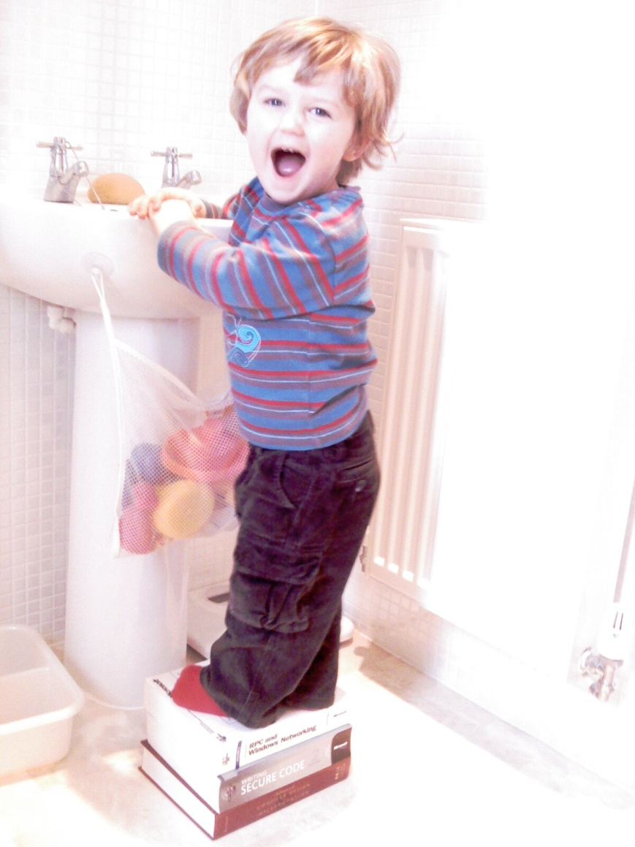
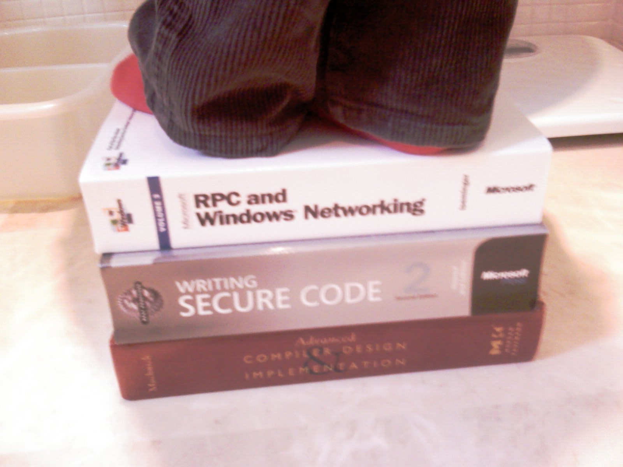
Good books

Slide 39
Questions?
Reporting vulns: secure@microsoft.com
Email us about other stuff
switech@microsoft.com

